Slide 1
Digital Image Processing
Associate Prof. Zhang Qingfeng(张庆丰)
Department of Computer Science, Jinan University
Room 415, Nanhailou Building, JNU
Email: zqf135@qq.com, tqfz@jnu.edu.cn
1

Slide 2
About me
2
I have got my PH. D. from Northwestern Polytechnique University in 2002. My major is aircraft manufacture engineering.
2003.3-present, A teacher in Jinan University.
2015.2-2016.1 Visiting scholar in Paris Observatory, France
My research area: Astronomy Image Processing， Augmented Reality(AR), Mobile Internet Applications

Slide 3
About the Course
3
Goal
Understanding and mastering the basic concepts and methods of digital image processing.
Prerequisite
Advance mathematics
Advance programming language such as c, c++, java.

Slide 4
References
4
Textbook
(美)Rafael C. Gonzalez., Richard E.Woods. 数字图像处理(第三版) (英文版), 电子工业出版社，2010
Original edition：
R. C. Gonzalez and R. E. Woods, Digital Image Processing (third edition), Prentice Hall, 2008.

Slide 5
References
5
Reference :
阮秋琦， 阮宇智译，数字图像处理（第三版），电子工业出版社，2011
A. K. Jain, Fundamentals of Digital Image Processing, Prentice Hall, 1989.
K. R. Castleman, Digital Image Processing, Prentice Hall, 1996.
许录平， 数字图像处理，科学出版社，2007
Internet resources

Slide 6
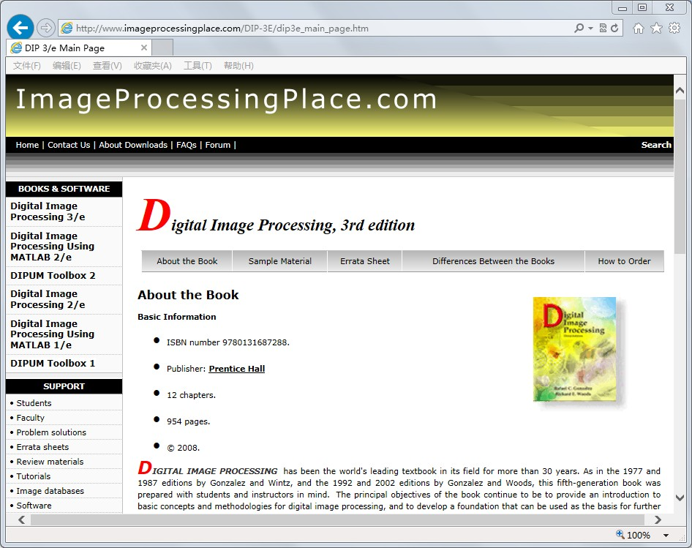
6

Slide 7
Grading System
7
Total score: 100 points
Attendance: 10%
Homework: 30%
Final Exams (closed book): 60%

Slide 8
Course Contents
Introduction
Digital Image Fundamentals
Image Enhancement in the Spatial Domain
Image Enhancement in the Frequency Domain
Image Restoration
Color Image Processing*
Image Compression*
8

Slide 9
Class representative
9
Duties:
Collecting and handing out students’ homeworks.
Building a bridge between you and me. Delivering message among us.
Who would like to do these jobs？
Name：
Wechat：

Slide 10
Chapter 1 Introduction
Preview
What is Digital Image Processing?
The Origins of Digital Image Processing
Examples of Applications
Fundamental Steps in DIP
10

Slide 11
Preview
One picture is worth more than ten thousand words. ---- Anonymous
Development of digital image processing is driven by
Human interpretation
Machine perception
11

Slide 12
For human interpretation
Improvement of pictorial information.
For autonomous machine perception
Processing of image data for storage, transmission, and representation.
12

Slide 13
What is Digital Image Processing?
13
What is an image?
What is a digital image?
What is digital image processing

Slide 14
What is Digital Image Processing?
An image may be defined as a
2-dimensional function, I=f (x, y)
where
(x, y) are spatial coordinates
I is the intensity or gray level of the image at that point (x, y)
When (x,y) and I are all finite, discrete quantities, we call the image a digital image
14

Slide 15
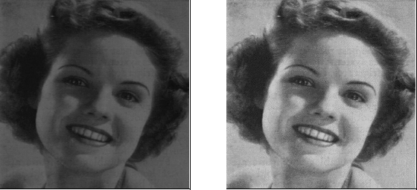
15
Digital image processing refers to processing digital images by means of a digital computer.

Slide 16
16
A digital image is composed of a finite number of elements, each of which has a particular location and value. These elements are called picture elements, image elements, pels and pixels. Pixel is most widely used.

Slide 17
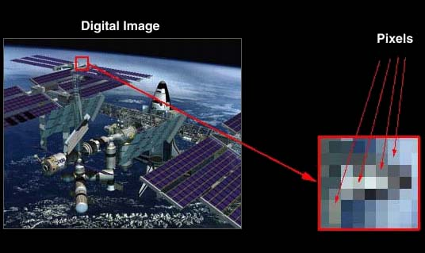
Pixels
17

Slide 18
Research Scope
18
Image processing(IP) has some related areas, such as image analysis and computer vision(CV).
There are no clear boundary between IP and its related areas.
Maybe, the distinct character of IP is that both the input and output of a process are images.

Slide 19
Research Scope
19
Of course, it is a limiting and somewhat artificial boundary.
For example, under the definition, computing the average intensity of an image (which yields a single number ) would not be considered an image processing operation.
Now, we can say there is no a clear definition about Image Processing.

Slide 20
IP vs. CV
image
image
20
Image Processing
Research area within electrical engineering /signal processing / computer science
Focus on syntax, low level features

Slide 21
IP vs. CV
Faces
People
Chairs
etc.
image
21
Computer Vision
Research area within computer science/ artificial intelligence
Focus on semantics, symbolic or geometric descriptions

Slide 22
Boundaries
There are no clear-cut boundaries in the continuum from IP to CV. But there are three types of computerized processes in the continuum:
Low Level Processes
Mid-Level Processes: processing of individual objects
High Level Processes: understanding groups of objects
22

Slide 23
Low Level Processes
Low level process involves primitive operations.
Primitive operations is some simple image processing such as reduce noise, contrast enhancement, image sharpening
A low-level process is characterized by the fact that both its inputs and outputs are images.
23

Slide 24
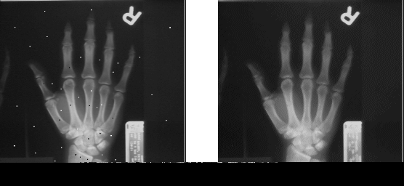
Example
24
Application of the median filter to reduce noise

Slide 25
Mid-Level Processes
25
A mid-level process is characterized by the fact that its inputs generally are images, but its outputs are attributes extracted from those images (e.g., edges, contours).
Involves the following tasks:
Segmentation:partitioning an image into regions or objects
Description: Description of these objects for computer processing
Recognition: Classification of individual objects

Slide 26
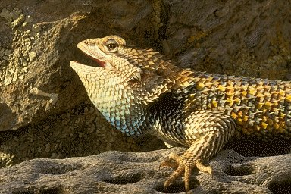
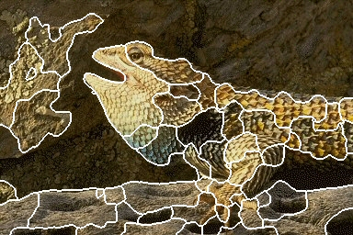
Example
26
a lizard segmented result

Slide 27
High Level Processes
27
Higher-level processing involves “making sense” of an ensemble of recognized objects.
includes understanding groups of objects
Image Understand
Image Classification
Vision Tasks

Slide 28
The origins of DIP
One of the applications of digital images was in the newspaper industry
In 1920s, the first digital picture was sent by submarine cable between London and New York
In the Bartlane cabel picture transmission system, pictures were coded in sending end for cable transmission and then reconstructed them at the receiving end. Figure1.1 shows an example.
28

Slide 29
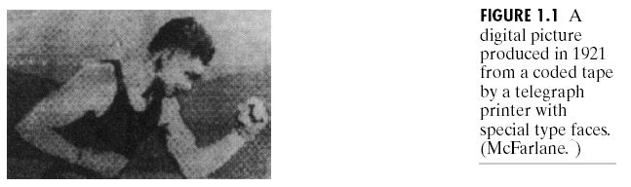
29

Slide 30
The origins of DIP
To improve the visual quality of these early pictures, the technique based on photographic reproduction was applied. Figure 1.2 shows an image obtained using this method.
30

Slide 31
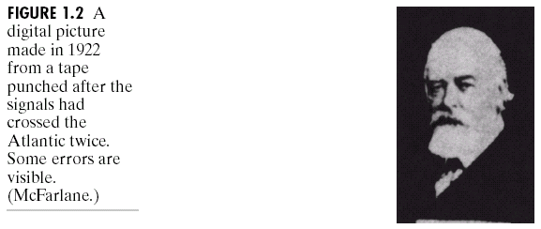
Its tonal quality is better than figure 1.1, and resolution is higher
31

Slide 32
The origins of DIP
In fact, the history of digital image processing is intimately tied to development of the digital computer, because the progress of digital image has been dependent on digital computer and its supporting technologies such as data storage, computation power, display, and transmission.
32

Slide 33
The origins of DIP
The first computers powerful enough to carry out meaningful image processing tasks appeared in the early 1960s.
JPL(Jet Propulsion Laboratory) used computer for improving images from a space probe Ranger 7 in 1964.
Figure 1.4 shows the first image of the moon taken by Ranger 7 on July 31, 1964 at 9:09 A.M.
33

Slide 34
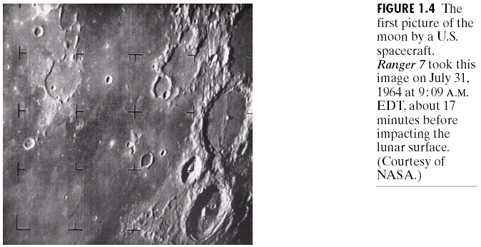
34
The first application of DIP based on computer

Slide 35
The origins of DIP
The image lessons learned with Ranger 7 served as the basis for improved methods used to enhance and restore images from the surveyor missions to the moon, the Mariner series of flyby mission to Mars, the Apollo manned flights to the moon, and others.
35

Slide 36
The origins of DIP
In parallel with space applications, digital image processing techniques began in the late 1960s and early 1970s to be used in medical imaging.
Computerized Tomography(CT) is one of the most important events in the application of DIP in medical diagnosis.
The inventors of the CT won the 1979 Nobel Prize in Medicine.
36

Slide 37
The origins of DIP
From the 1960s until the present, the field of image processing has grown vigorously.
In addition to application in medicine and the space program, digital image processing techniques now are used in a broad range of applications including geography, archeology, biology, astronomy, law enforcement, industry and so on.
37

Slide 38
The areas of application of DIP
38
The areas of application of digital image processing are varied.
For developing a basic understanding of the extent of image processing applications, one of the simplest ways is to categorize images according to their source.

Slide 39
The areas of application of DIP
39
The principle energy source for images in use today is
Electromagnetic (EM) energy spectrum
Discuss how images are generated in these various categories and the areas in which they are applied.

Slide 40
Electromagnetic energy spectrum
40
Images based on radiation from the EM spectrum are the most familiar, especially images in the X-ray and visual bands of the spectrum.
Gamma rays
X-rays
Ultraviolet
Visible
Infrared
Microwaves
Radio waves

Slide 41
If spectral bands are grouped according to energy per photon, the spectrum is shown in the following figure:
41

Slide 42
Gamma-Ray Imaging
42
Major use of imaging based on gamma rays include nuclear medicine and astronomical observations.
The following figure shows some images from gamma rays.

Slide 43
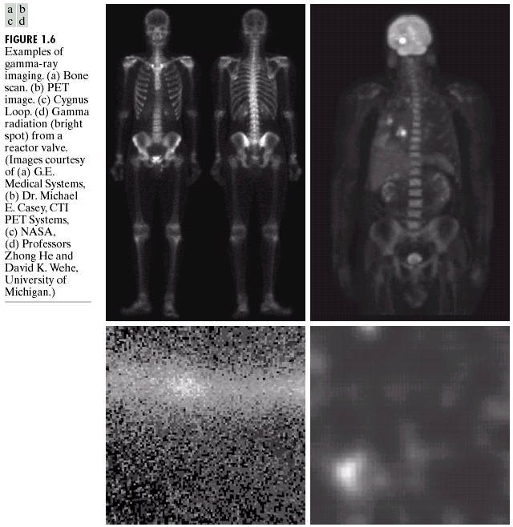
43

Slide 44
X-Ray Imaging
44
The best known use of X-rays is medical diagnostics, but they also are used extensively in industry and other areas, like astronomy.
The following figure shows some examples using x-ray imaging

Slide 45
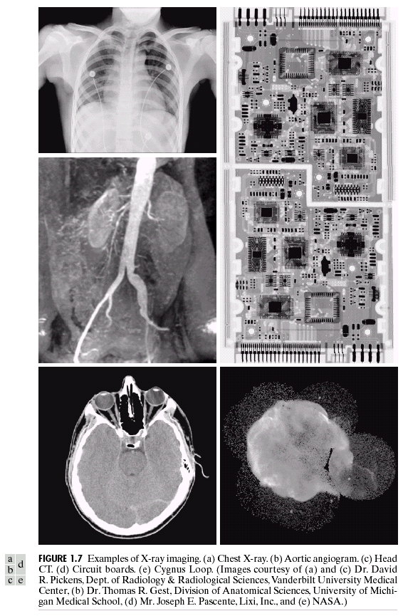
45

Slide 46
Imaging in the Ultraviolet Band
46
Applications of ultraviolet “light” are varied. They include industrial inspection, microscopy, lasers, biological imaging, and astronomical observations.
The below figure shows some examples from microscopy and astronomy.

Slide 47
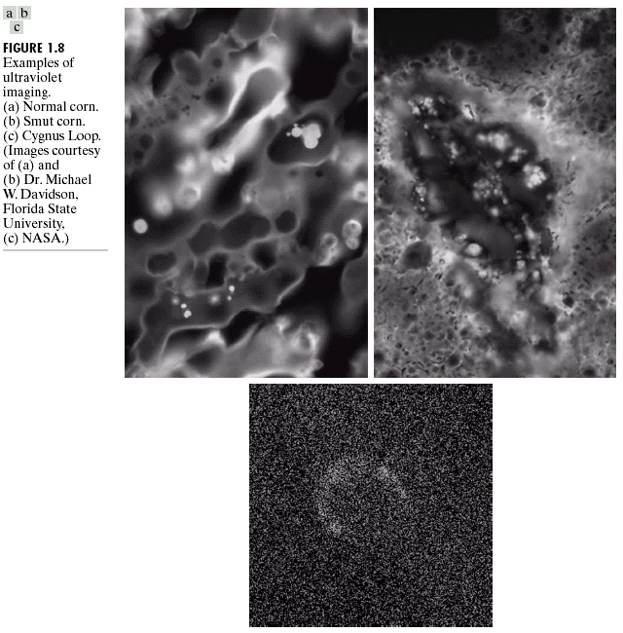
47

Slide 48
Imaging in the visible and infrared bands
48
The infrared band often is used in conjunction with visual imaging, so we have grouped the visible and infrared bands in this section.
Visible band of the EM spectrum is the most familiar in our activities.
The following figures show their application in light microscopy, astronomy ,remote sensing and law enforcement.

Slide 49
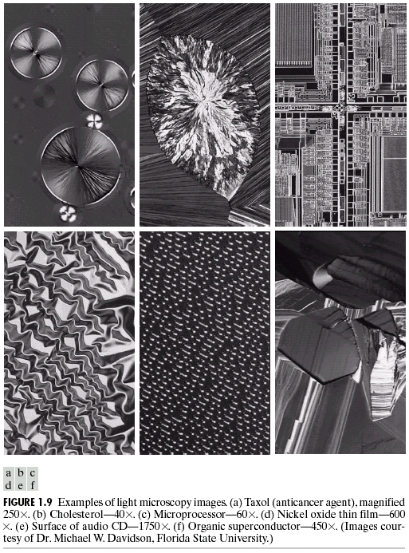
49

Slide 50
Multiband imaging of LANDSAT
50
Another major area of visual processing is remote sensing.
NASA has launched a remote sensing satellite, LANDSAT.
Its primary function is obtain images of the Earth from space.
It use several band in the visual and infrared regions of the spectrum to obtain image.
The below table shows its thematic bands.

Slide 51
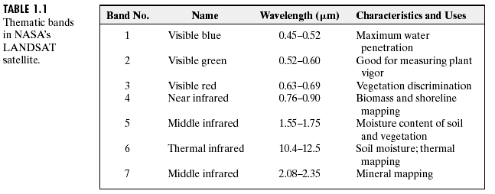
51

Slide 52
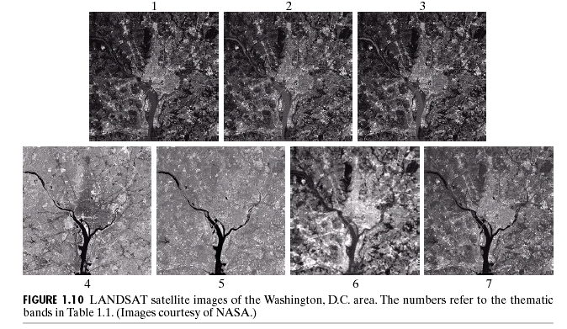
An example of Multi-spectral Image
52

Slide 53
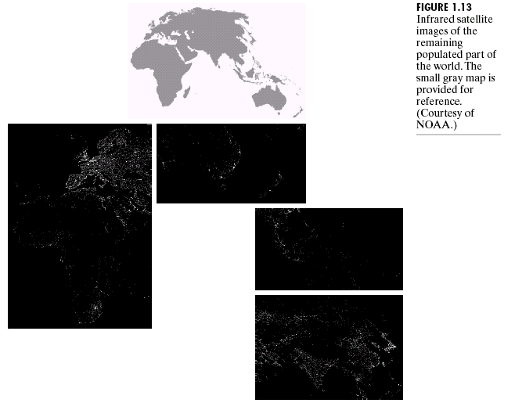
53

Slide 54
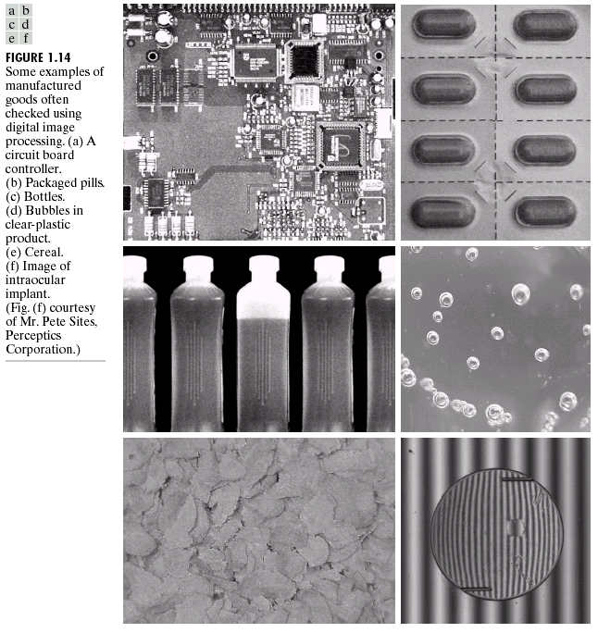
54

Slide 55
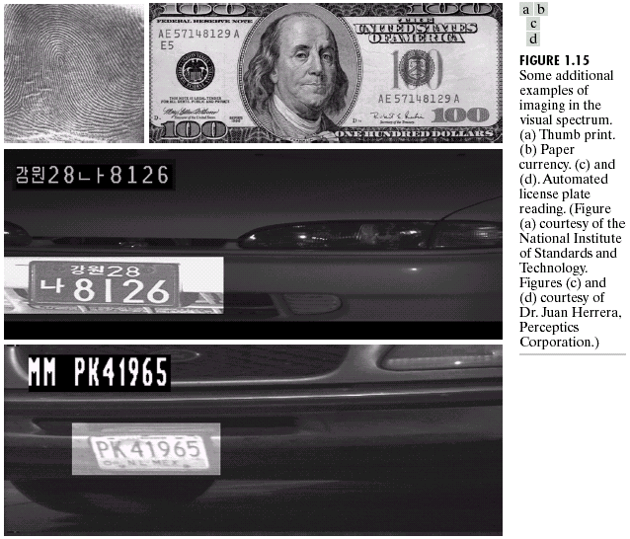
Another example
55

Slide 56
Imaging in the Microwave Band
56
The dominant application of imaging in the microwave band is radar.
The unique feature of imaging radar is its ability to collect data over virtually any region at any time, regardless of weather or ambient lighting conditions.
So radar’s main application is in military to detect the flying airplanes.

Slide 57
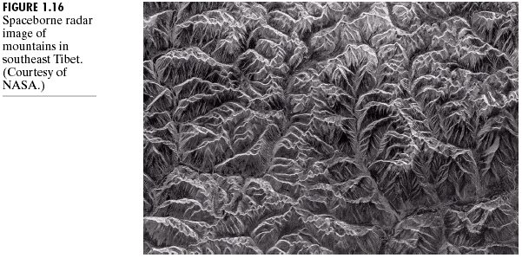
Rugged mountainous area, About 90 km east of the city of Lhasa
57

Slide 58
Imaging in the Radio Band
58
As gamma rays, the major applications of imaging in the radio band are in medicine and astronomy.
In medicine, radio waves are used in magnetic resonance imaging (MRI), which produces a two-dimensional picture of a section of the patient.

Slide 59
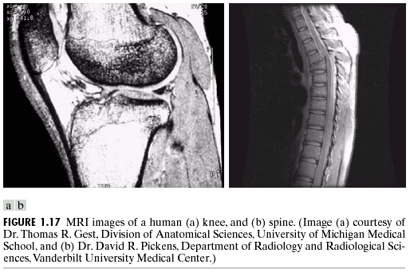
Imaging in the Radio Band
59

Slide 60
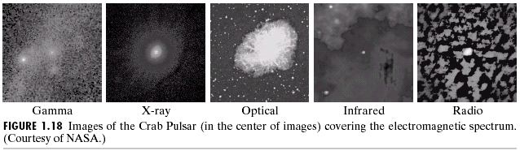
This is a example of application in astronomy.
60

Slide 61
Other Imaging Modalities
61
Acoustic Imaging
Imaging using “sound”
Electron Microscopy
using a focused beam of electrons to image a specimen.
Synthetic imaging
Images are generated by computer.

Slide 62
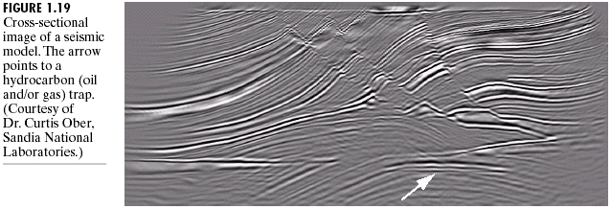
62

Slide 63
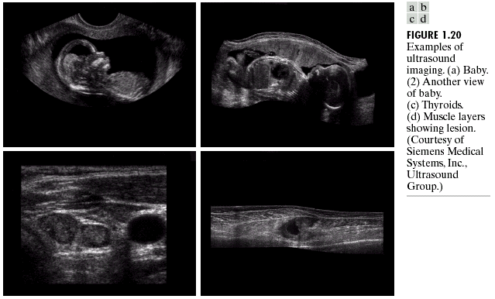
Imaging with UltraSound
63

Slide 64
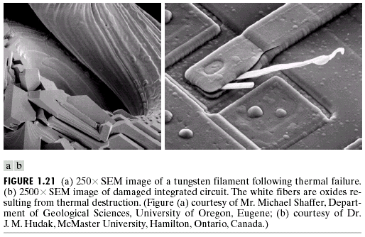
Imaging with Electron Microscopy
64

Slide 65
Fundamental Steps in DIP
65
Image Acquisition
Preprocessing
Segmentation
Representation and Description
Recognition

Slide 66
66

Slide 67
Image Acquisition
67
The first process of image processing, foundation of any vision system.
Imaging sensor that can digitize the signal collected by them
Video camera
Digital camera
Conventional camera & analog-to-digital converter

Slide 68
Image enhancement
aim
to improve the interpretability or perception of information in images for human viewers;
to provide `better' input for other automated image processing techniques.
68

Slide 69
Image enhancement
69
Image enhancement techniques are very subjective, and can be divided into two broad categories:
Spatial domain methods, which operate directly on pixels
frequency domain methods, which operate on the Fourier transform of an image.

Slide 70
Example 1
70
Image enhancement with spatial methods

Slide 71
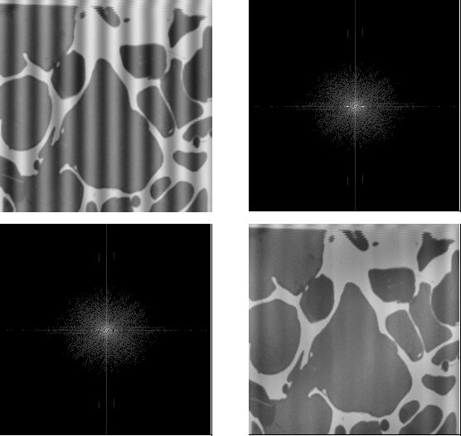
Example 2
Fourier spectrum
71
Image enhancement with frequency methods

Slide 72
Image Restoration
Restoration attempts to reconstruct or recover an image that has been degraded by using a priori knowledge of the degradation phenomenon.
Objective: the judgment of image restoration result is objective, not based on human subjective preferences.
It tends to be based on mathematical or probabilistic models of image degradation.
72

Slide 73
Color Image Processing
73
Because of the significant increase in the use of digital images over the internet, CIP has been gaining in importance. The chapter 6 covers
the fundamental concepts in color models
Basic color processing

Slide 74
Image Compression
74
Aim: Reducing the storage required to save an image, or the bandwidth required to transmit it.
Storage technology has improved significantly, but transmission capacity hasn’t been obtained the same improvement, so the compression is necessary.

Slide 75
Image Segmentation
75
Task: Partition an image into its constituent(构成的) parts or objects
Autonomous segmentation is one of the most difficult tasks in DIP
The more accurate the segmentation, the more likely recognition is to succeed

Slide 76
Representation and Description
76
Representation of raw pixel data with either the boundary of a region, or all the points in the region itself.
Boundary representation for focusing external shape characteristics, like corners and inflections
Region representation for focusing internal properties, like texture or skeletal shape

Slide 77
Representation and Description
77
Description or Feature selection:
Extracting attributes that result in some quantitative information of interest or are basic for differentiating one class of objects from another.

Slide 78
Recognition & Interpretation
78
Recognition
To assign a label to an object based on information provided by the descriptors
Interpretation
To assign meaning to a group of recognized objects

Slide 79
Summary
79
Understand some imaging methods based on Electromagnetic energy spectrum or based on acoustic, ultrasonic and electronic.
Understand some fundamental steps in digital image processing

Slide 80
Homework
80
Please propose a novel idea about the application of the DIP technique that can improve the people’s lives.
The idea can be a product, a system or anything else.
A detailed description about your idea is welcome.
Pleas finish it within 2 weeks.
Send your hardcopy to course website.

Slide 81
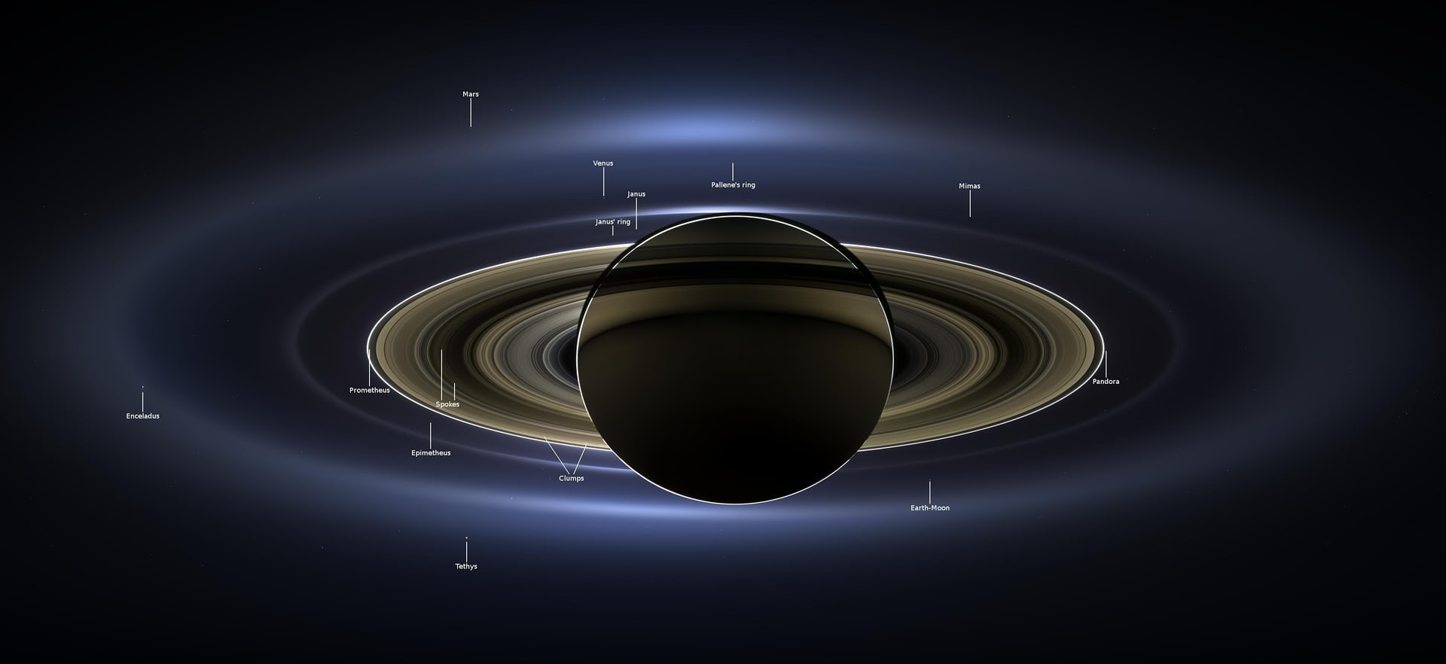
81

Slide 82
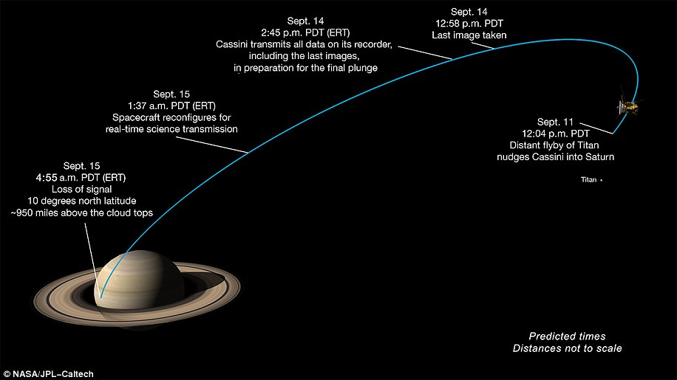
82

Slide 83
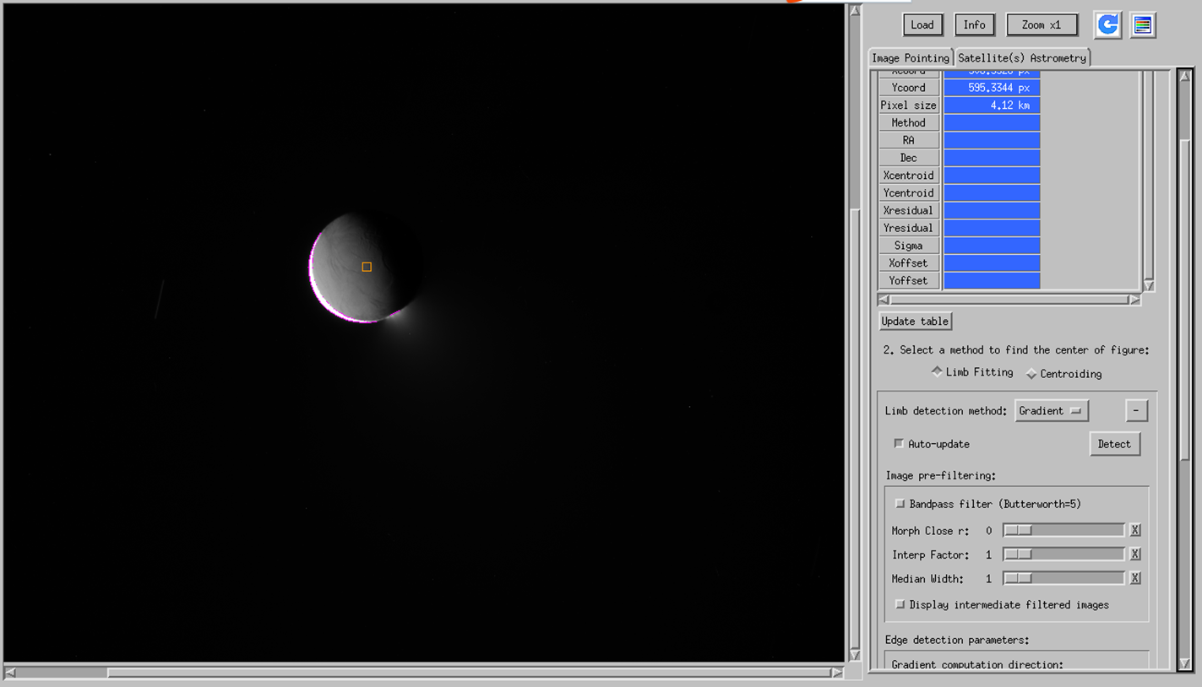
83

Slide 84
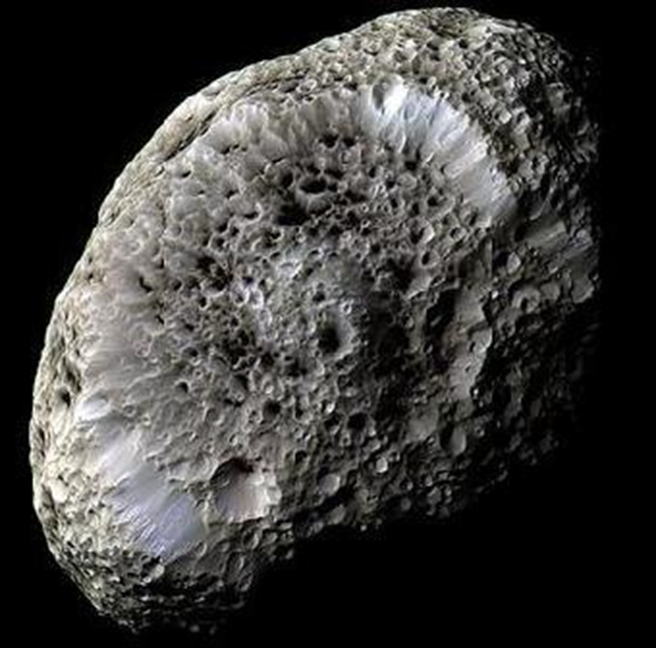
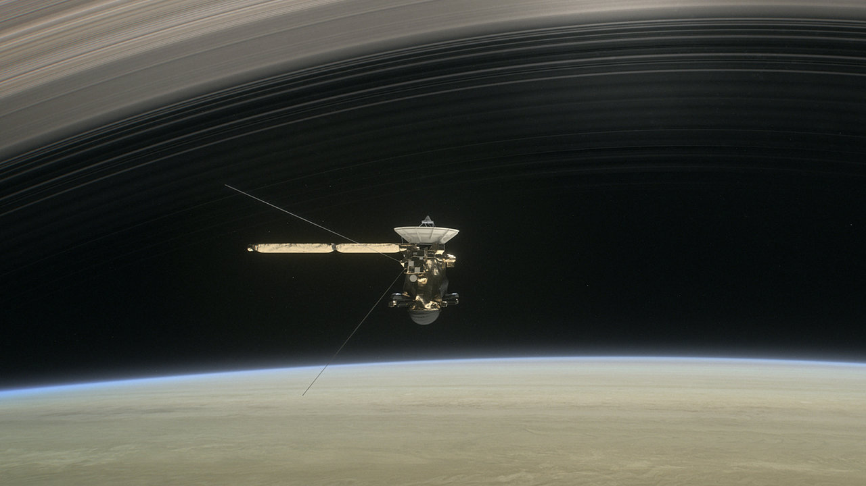
84

Slide 85
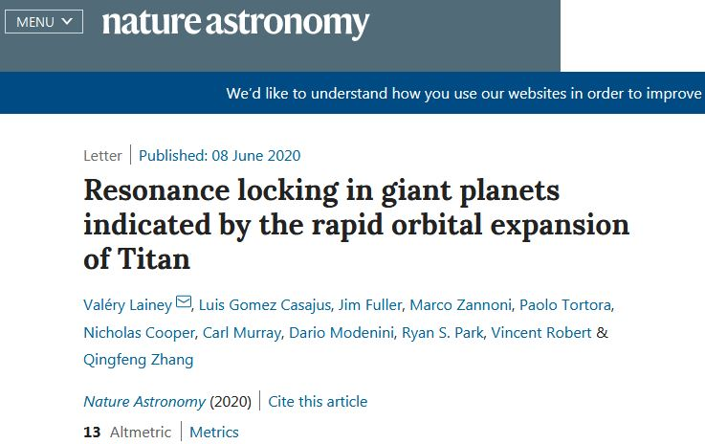

Slide 86

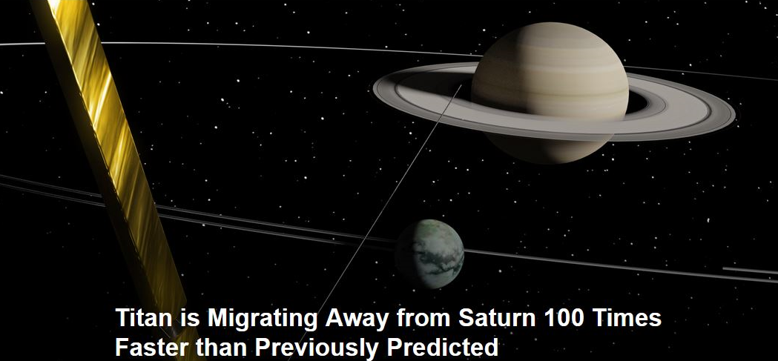

Slide 87
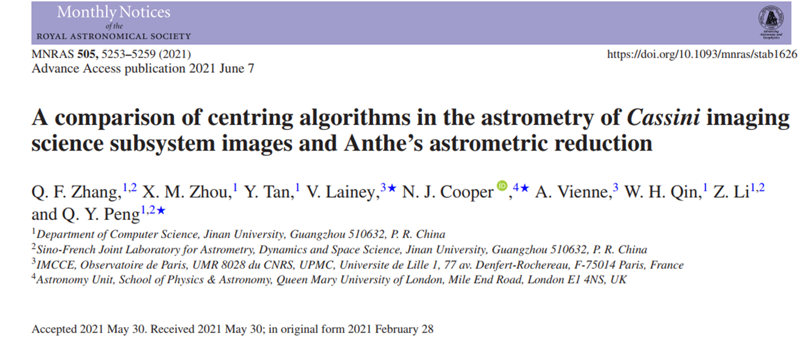
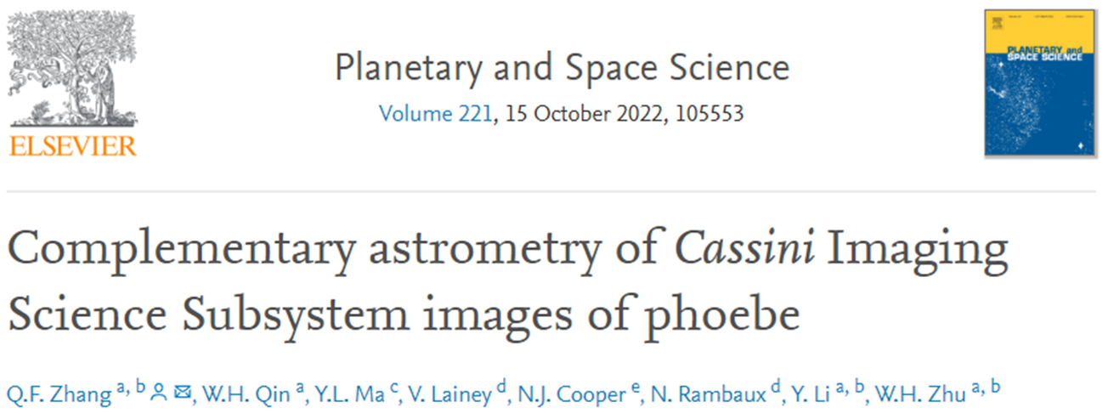
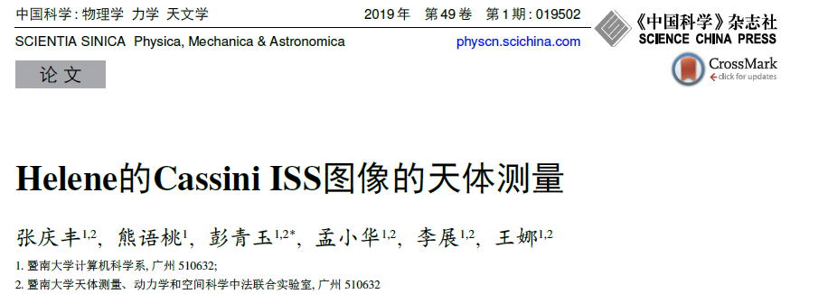

Slide 88
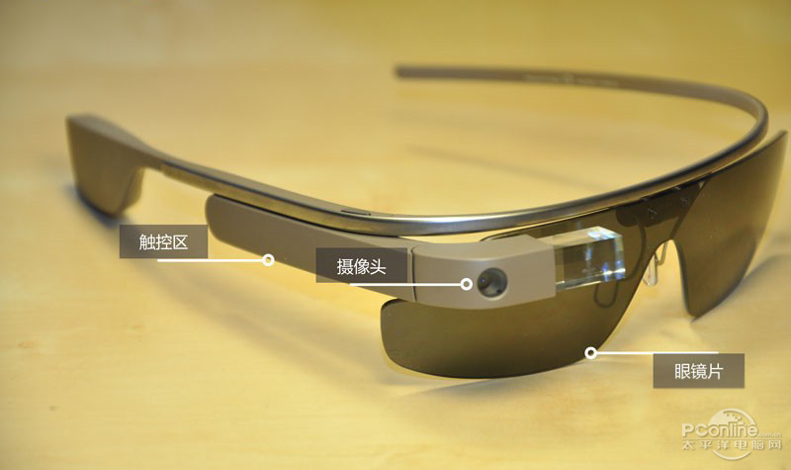
AR Glasses
88

Slide 89
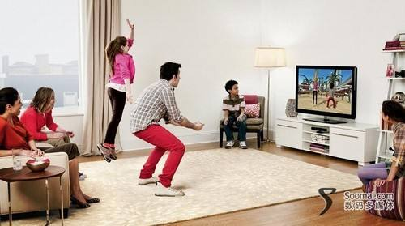
Motion Sensing Game
89

Slide 90
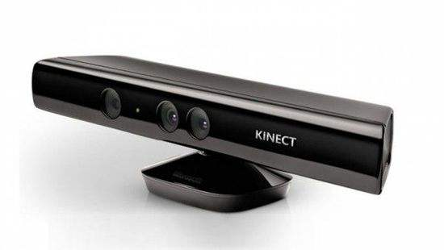
Kinect
90

Slide 91
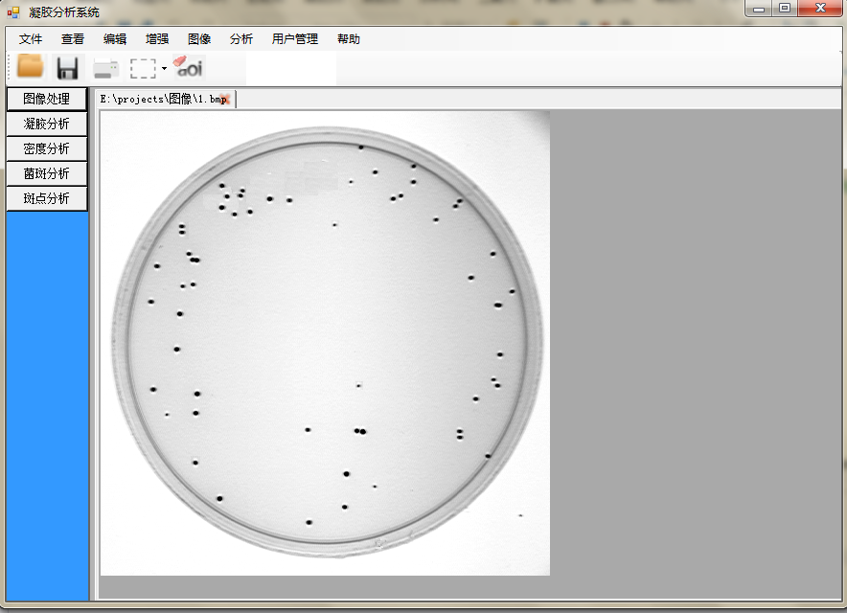
91

Slide 92
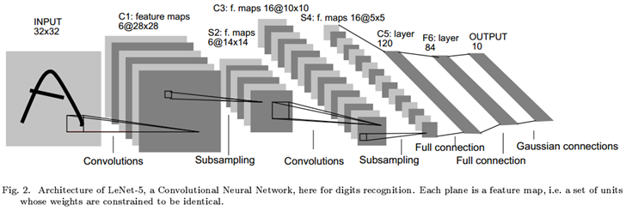
92

Slide 93
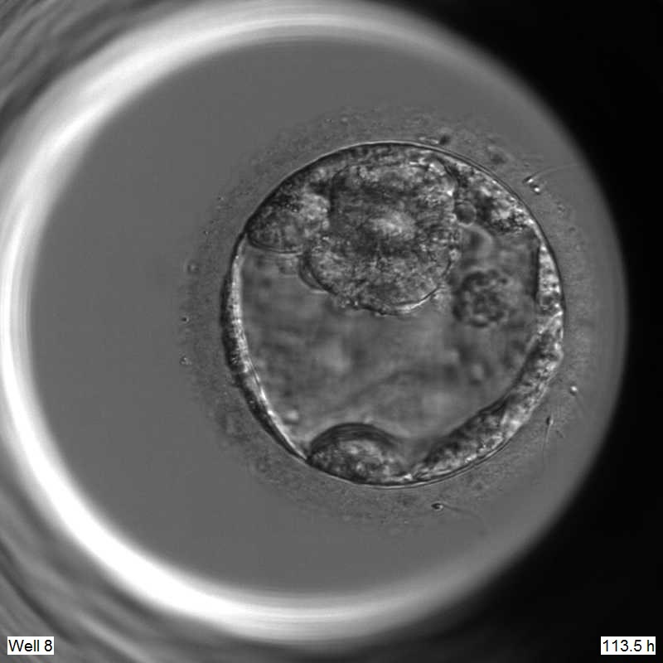
Quality of embryo

Slide 94
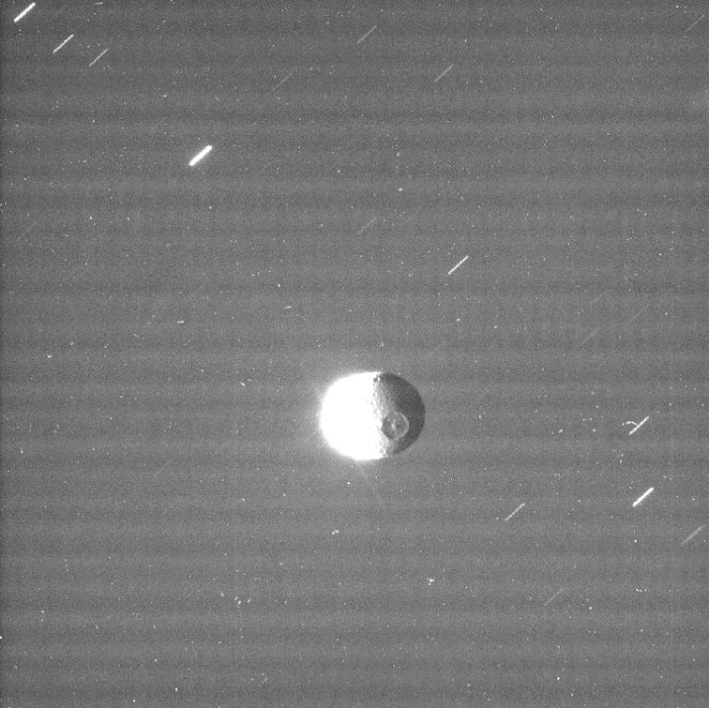
Problems in Astronomy Images
How to restore these streaks into point source

Slide 95
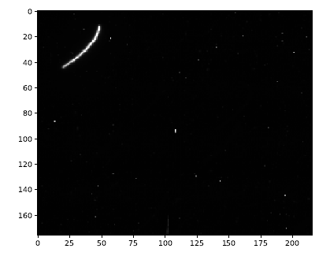
How to get the streak’s center position.

Slide 96
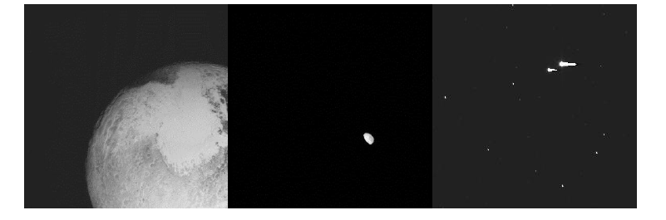
How to get these object’s center positions.

Slide 97
97
Thank you.

